Slide 1
Capstone Project - The Battle of Neighborhoods
City of London

Slide 2
Table of Contents
This works is presented in the following parts as shown below:
Introduction
Data
Methodology
Result
Discussion and Conclusion

Slide 3
Introduction
The population of London has grown considerably over the last decades
The real deal is that as much as there are many fine restaurants in London – Asian, Middle Eastern, Latin and American restaurants, you can struggle to find good place to dine in the finest of West African cuisine that has combination of Nigerian, Ghanaian, Cameroonian, Senegalese and more.
My client, a successful restaurant chain in Africa is looking to expand operation into Europe through London.
Since the London demography is so big, my client needs deeper insight from available data in other to decide where to establish the first Europe “palace” restaurant.
This company spends a lot on research and provides customers with data insight into the ingredients used at restaurants.

Slide 4
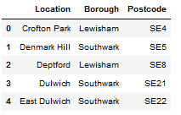
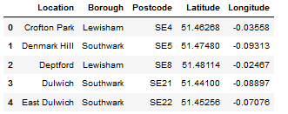
Data 1
This project will rely on public data from Wikipedia and Foursquare.
The London Area consists of 32 Boroughs and the "City of London". Our data will be from the link - Greater London Area https://en.wikipedia.org/wiki/List_of_areas_of_London
In obtaining the location data of the locations, the Geocoder package is used with the arcgis_geocoder to obtain the latitude and longitude of the needed locations.
The Foursquare API will be used to obtain the South East London Area venues for the geographical location data . These will be used to explore the neighborhoods of London accordingly.
Data 2

Slide 5
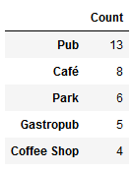
METHODOLOGY
An initial exploration of a single Neighbourhood within the London area was done to examine the Foursquare workability. The Lewisham Borough postcode SE13 and Location - Lewisham is used for this.
Interestingly, even though there are restaurants are the Lewisham area, they are not even in the top 5 venues. It should be noted that since we are limited by data availability, our perspectives will be on what we have.

Slide 6
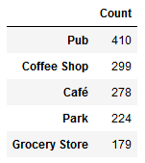
Now let's explore (Multiple) Neighborhoods in the South East London area. To do this, the function getNearbyVenues is used and it's created to repeat the same process for all neighborhoods.

Slide 7
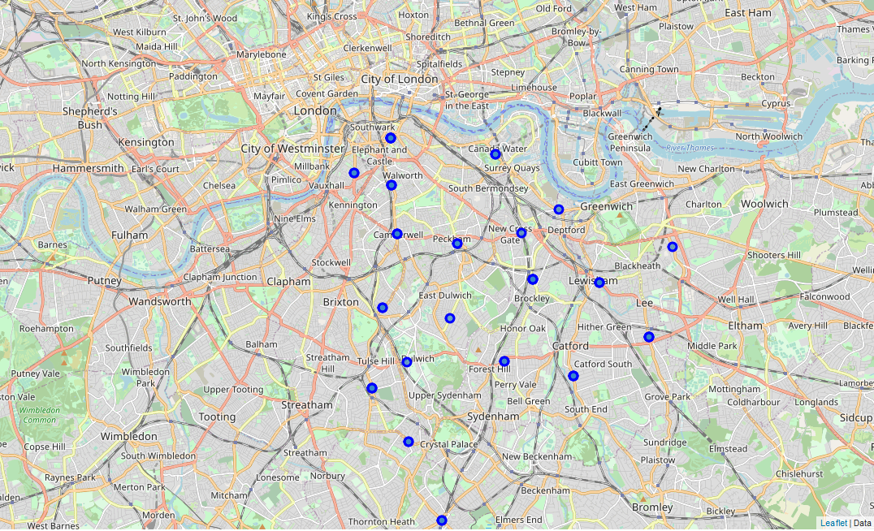
the neighbourhoods in South East London will be clustered based on the processed data

Slide 8
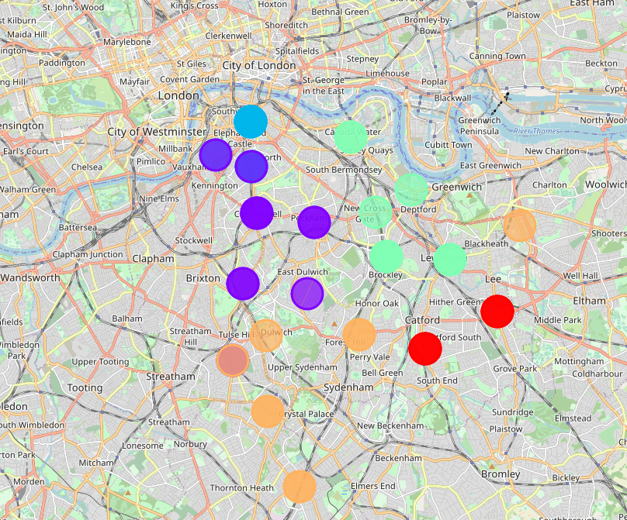
K-means was used to cluster the neighborhood into 5 clusters.
To get the optimal number of clusters to be used for the K-mean, the following methods are used:
The Elbow method and the Silhouette Coefficientis

Slide 9
RESULTS
Pubs, Cafe, Coffee Shops are popular in the South East London.
As for restaurants, the Italian Restaurants are very popular in the South East London area. Especially in Southwark and Lambeth areas.
With the Lewisham area being the most condensed area of Africans in the South East Area, it is surprising to see how in the top 10 venues, you can barely see restaurants in the top 5 venues.
Although, the Clusters have variations, a very visible presence is the predominance of pubs.
It is very important to note that Clusters 2 and 3 are the most viable clusters to create a brand African Restaurant. Their proximity to other amenities and accessibility to station are paramount.
In conclusion, this project would have had better results if there were more data in terms of crime data within the area, traffic access and allowance of more venues exploration with the Foursquare (limited venues for free calls).
Also, getting the ratings and feedbacks of the current restaurants within the clusters would have helped in providing more insight into the best location.

